Slide 1
COMPUTER NETWORKS
Dr. S. Sathya Priya,
Associate Professor,
School of Computing Sciences.

Slide 2
Data communication
Communicate-Sharing Information
Sharing-Local or Remote
Telecommunication- Telegraphy, Telephone, Television.(far)
Date-information presented in whatever form that is agreed upon by parties creating and using data.
Data Communication- Exchange of data between two devices via transmission medium
Communication devices must be part of communication system(Combination of hardware and software)
Effectiveness of Communication System depends on 4 fundamental characteristics:
Delivery
Accuracy
Timeliness(real-time transmission)
Jitter(variation in packet arrival time)

Slide 3
components
5 Components:
Message(Texts, numbers, pictures, audio, video)
Sender
Receiver
Transmission Medium(twisted-pair wire,coaxial cable, fibre-optic cable, radio waves)
Protocol(set of rules that govern data communication)

Slide 4
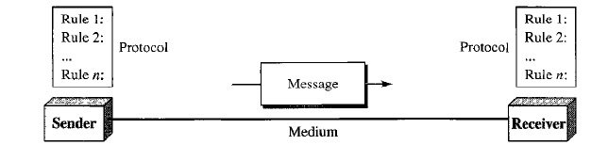

Slide 5
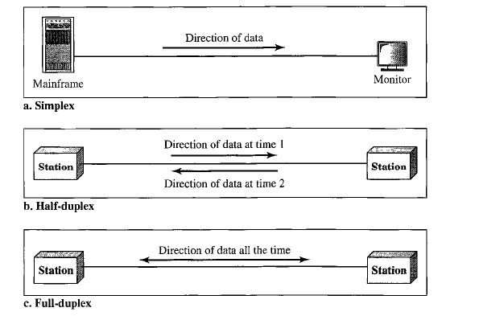
Data flow
Communication between two devices can be:
Simplex,
Half-duplex
Full-duplex

Slide 6
networks
Set of devices(nodes) connected by communication links.
Distributed Processing: Networks use distributed processing.
Network Criteria:
Performance: Measured using transit time and response time.
Transit time: Amount of time required for a message to travel from one device to another.
Response time: Elapsed time between an enquiry and a response.
Performance depends on:
Number of users
Type of transmission medium
Capabilities of connected hardware
Efficiency of software.
Performance evaluated by two metrics: Throughput and Delay
Reliability: Measured by frequency of failures, time it takes for a link to recover from failures.
Security: Protecting data from unauthorised access, from damage and development, implementing policies and procedures for recovery.

Slide 7
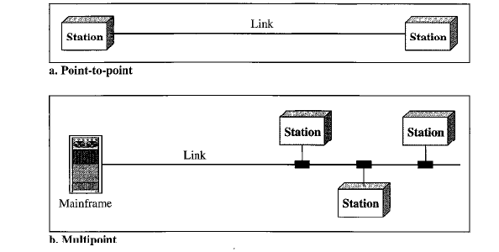
Network attributes
Type of Connection:
Point-to-point
Multi-point (multi-drop)
Physical Topology
Geometric representation
Of all the links & linking
devices to one another.
4 basic topologies:

Slide 8
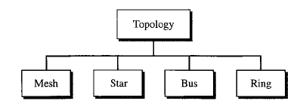

Slide 9
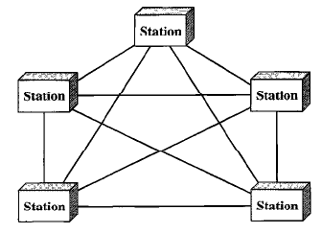
Mesh networks
Every device has a dedicated point-to-point link to every other device.
Number of physical links:
n(n-1)
For full-duplex links,
n(n-1)/2
Every device on the network must have
(n-1) I/O ports to be connected to n-1 stations.

Slide 10
Advantages
Each connection carry its own data load.(Eliminate traffic problems)
Mesh topology is robust.
Privacy and Security
Point-to-point link make fault identification and fault isolation easy.(N/W manager can find precise fault location and aids in finding the cause and solution)

Slide 11
disadvantages
Amount of cabling and no. of I/O ports used
Installation and re-connection are difficult
Sheer bulk of cabling can be greater than available space
H/w required to connect each link can be very expensive
Usually implemented in limited fashion
Example: Connection of telephone regional offices.

Slide 12
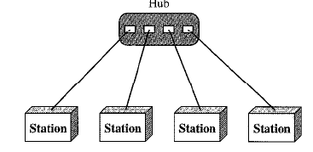
Star topology
Each device have a dedicated point-to-point link only to central controller(Hub).
Devices are not directly linked to
one another
Does not allow direct traffic between
devices.
Controller acts as exchange.

Slide 13
ADVANTAGES:
Less expensive(1link & 1 I/O port)
Easy to install and reconfigure
Addition, moves, deletion easy.
Robust
Easy fault identification and isolation
DISADVANTAGES:
If hub goes down whole system is dead.
More cables required compared to Bus and Ring

Slide 14
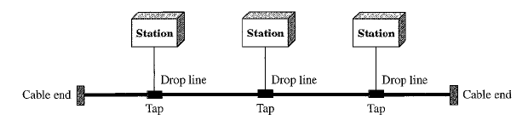
Bus toplogy
Multi-point connection
Long cable acts as backbone to all connecting devices.
Nodes are connected to bus cable by drop lines and Taps.
Tap is connector that either splices into the main cable or punctures the sheathing of a cable to create contact with metallic core.

Slide 15
ADVANTAGES:
Ease of installation.
Less cabling
Redundancy is eliminated.
DISADVANTAGES:
Difficult reconnection and fault isolation
Signal reflection at the taps cause degradation in quality.
Adding new devices require modification or replacement of the backbone.
Fault or break in the bus cable stops all transmission.
Signal becomes weaker as it travels farther.
Used in LAN

Slide 16
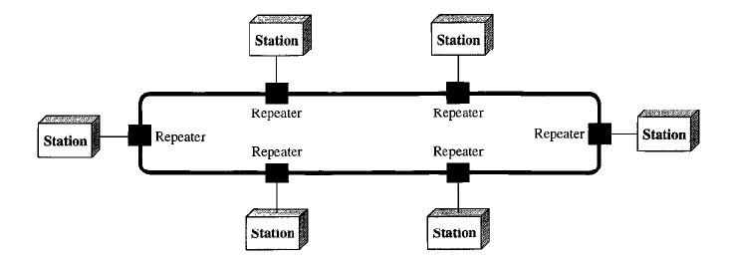
Ring toplogy
Each device has a dedicated point-to-point connection with only 2 devices on either side.
Each device incorporates a Repeater.

Slide 17
ADVANTAGES:
Easy to install and reconfigure
Fault isolation is simplified.
DISADVANTAGES:
Media and traffic considerations( Max. ring length and no. of devices)
Unidirectional traffic.
A break in the ring can disable the entire network.
Less popular due to the need for high-speed LANs.

Slide 18
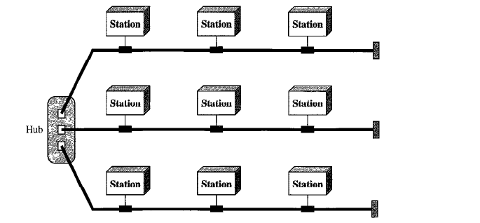
Hybrid topology
Combination of star and bus topology.

Slide 19
Network models
OSI (Open System Interconnection )-7 layers
Internet Model- 5 layers

Slide 20
Categories of networks
Determined by size of the network.
LAN(Local Area Network)- area less than 2 miles
WAN(Wide Area Network)-worldwide.
Inbetween are normally referred as MAN

Slide 21
Local area networks
Privately owned.
Links devices in a single office, building or campus.
Can be single connection between 2 PCs and a printer or can be extended throughout a company.
Size limited to few kilometers.
Allow resources to be shared between personal computers and workstations.
LAN also distinguished by their transmission media and topology
Common are bus, ring and star.
Data rates 4-16 Mbps.
Now speeds are generally 100 or 1000Mbps.
WLAN came later.

Slide 22
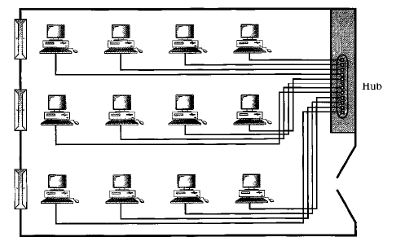

Slide 23
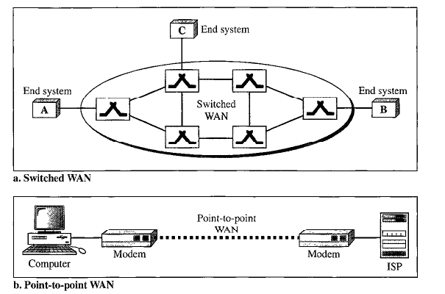
Wide area network

Slide 24
Provides long-distance transmission of data, image,audio and video info over large geographic areas.
Backbone that connect the internet- switched WAN.
Dial-up line that connects home computer to internet.-Point-to-point WAN.
Switched WAN connects end-systems to another LAN or WAN.
Point-to-point connects home computer or small LAN to Internet Service Provider.

Slide 25
Metropolitan area network
Size between Lan and WAN.
Covers area inside town or city.

Slide 26
Internet
Interconnection of Networks

Slide 27
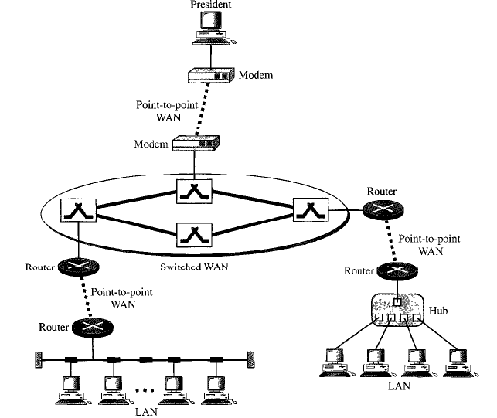

Slide 28
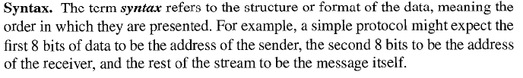

Protocols and standards
Key elements:
Syntax, Semantics and timing

Slide 29
Iso/OSI Model History
Rapid growth of computer networks caused compatibility problems
ISO recognized the problem and released the OSI model in 1984
OSI stands for Open Systems Interconnection and consists of 7 Layers
The use of layers is designed to reduce complexity and make standardization easier

Slide 30
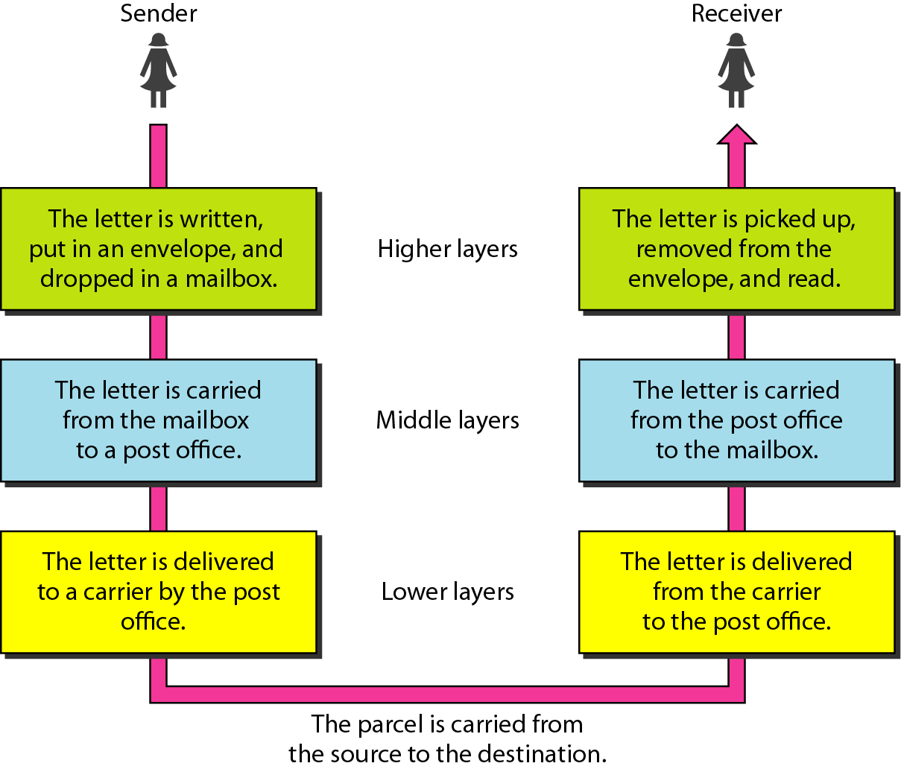
Tasks involved in sending a letter

Slide 31
2-2 THE OSI MODEL
Established in 1947, the International Standards Organization (ISO) is a multinational body dedicated to worldwide agreement on international standards. An ISO standard that covers all aspects of network communications is the Open Systems Interconnection (OSI) model. It was first introduced in the late 1970s.
Topics discussed in this section:
Layered Architecture Peer-to-Peer Processes
Encapsulation

Slide 32
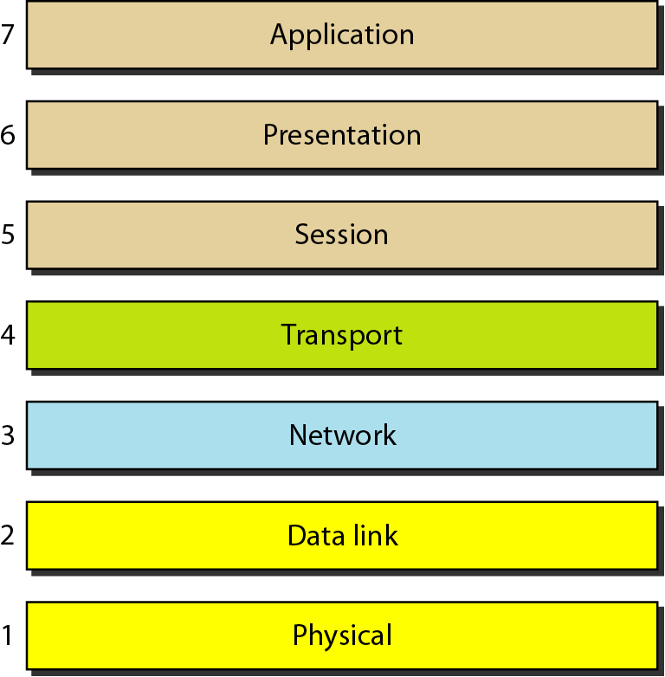
Iso/OSI Model
ISO is organization. OSI is a model.
All People Seem To Need Data Processing

Slide 33
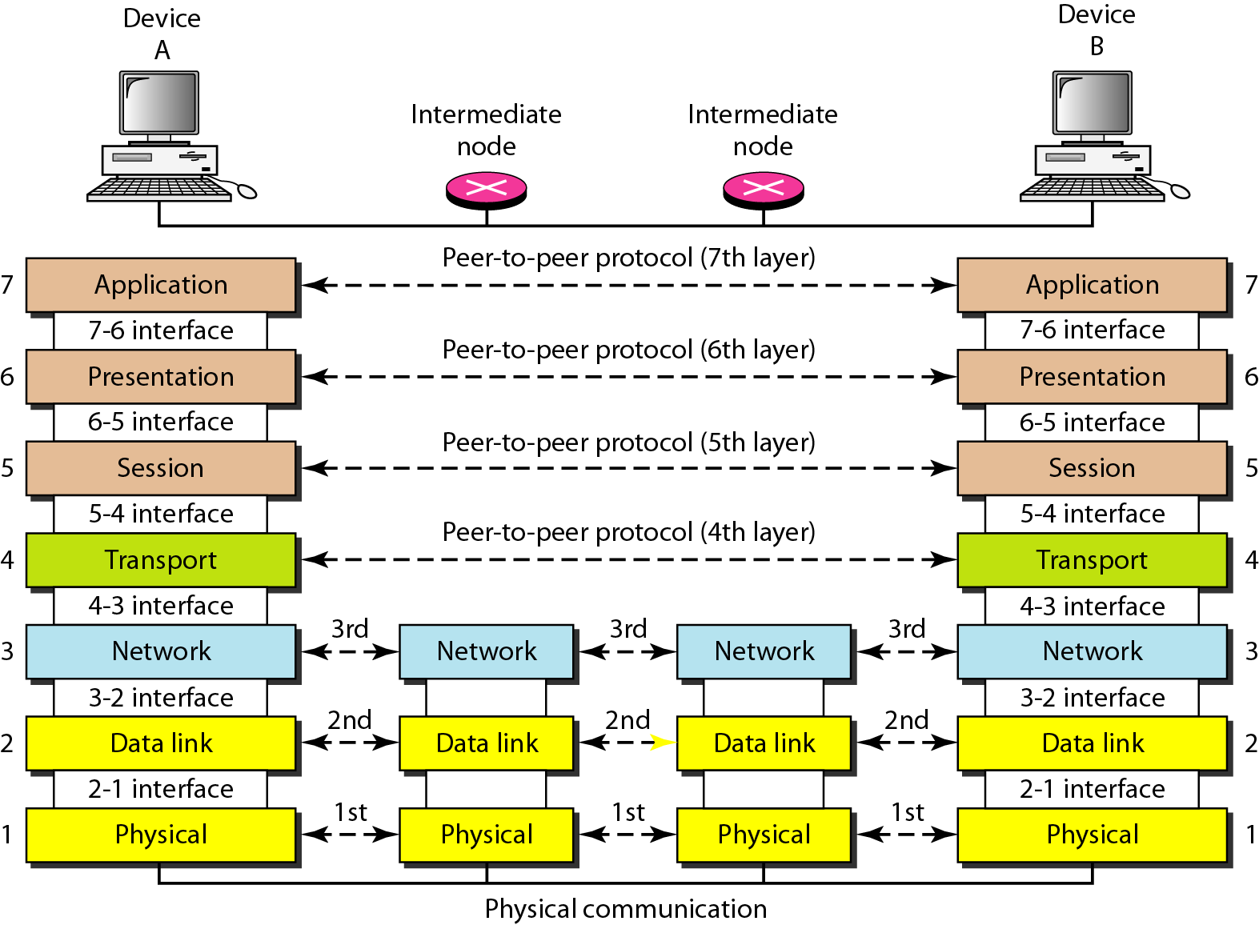
Figure 2.3 The interaction between layers in the OSI model

Slide 34
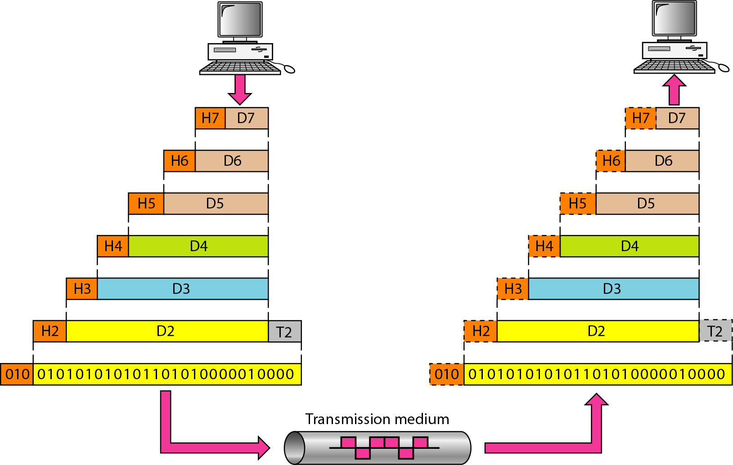
Figure 2.4 An exchange using the OSI model

Slide 35
7 Layers of the OSI Model
Layer | Responsible For:
7.) Application | Provides Services to User Apps
6.) Presentation | Data Representation
5.) Session | Communication Between Hosts
4.) Transport | Flow Ctrl, Error Detection/Correction
3.) Network | End to End Delivery, Logical Addr
2.) Data Link | Media Access Ctrl, Physical Addr
1.) Physical | Medium, Interfaces, Puts Bits on Med.

Slide 36
Examples
Layer | Example
7.) Application | HTTP, FTP, SMTP
6.) Presentation | ASCII, JPEG, PGP
5.) Session | BOOTP, NetBIOS, DHCP, DNS
4.) Transport | TCP, UDP, SPX
3.) Network | IP, IPX, ICMP
2.) Data Link | Ethernet, Token Ring, Frame Relay
1.) Physical | Bits, Interfaces, Hubs

Slide 37
Flat Addressing
Flat addressing schemes do not provide anything other than a unique identifier. They provide no real information about where the object being addressed resides.
Example: SSN# (may provide insight to where the person was born, but not to where they are now)

Slide 38
Hierarchical Addressing
Hierarchical addressing schemes provide layers or a hierarchy to the address that provide information about where the addressed object exists within the hierarchy.
Example: phone numbers (area code, local prefix, and four digit number unique to that area code/prefix combination).

Slide 39
Talking to Everyone
Special kinds of addresses exist at both layer #2 and #3 called broadcast addresses
Typically network devices are interested in only traffic addressed directly for them and any traffic addressed with the destination address set to broadcast
If they are paying attention to other traffic, they are said to be in promiscuous mode

Slide 40
Encapsulation
Data exists at each layer contained within a unit called a Protocol Data Unit (PDU).
PDU’s are referred two ways: N-PDU, and by special names.
The process by which data moves between PDU types is called Encapsulation
PDU move through interfaces between layers using Service Access Points (SAP)

Slide 41
PDU’s And the OSI Model
Layer | PDU Name
7.) Application | Data
6.) Presentation | Data
5.) Session | Data
4.) Transport | Segment
3.) Network | Packet
2.) Data Link | Frame
1.) Physical | Bits
Decapsulation
Encapsulation

Slide 42
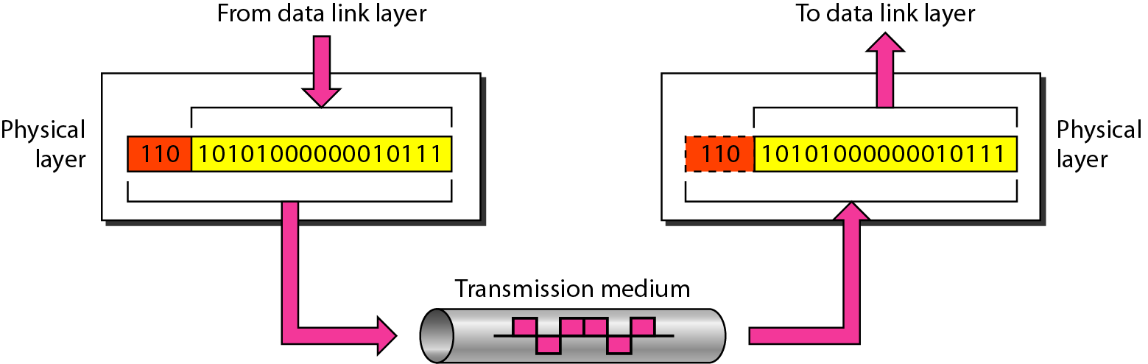
Physical layer

Slide 43
Layer 1: The Physical Layer
Defines physical medium and interfaces
Determines how bits are represented
Controls transmission rate & bit synchronization
Controls transmission mode: simplex, half-duplex, & full duplex
PDU: Bits
Devices: hubs, cables, connectors, etc…
The physical layer is responsible for movements of individual bits from one hop (node) to the next

Slide 44
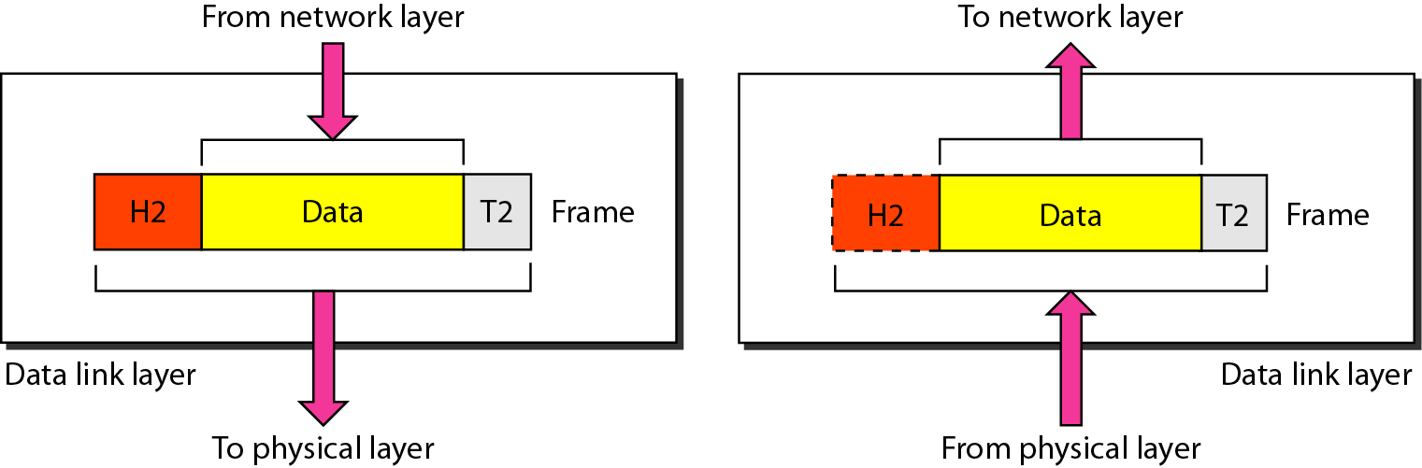
Data link layer

Slide 45
Layer 2: The Data Link Layer
PDU: Frames
Keeps Link alive & provides connection for upper layer protocols
Based on physical (flat) address space
Physical addresses are fixed and don’t change when the node is moved
Medium/media access control

Slide 46
The Data Link Layer (cont.)
Flow control and error detection/correction at the frame level. Think collisions…
Topology
Ex: Ethernet, Token Ring, ISDN
Sublayers: MAC (framing, addressing, & MAC) & LLC (logical link control – gives error control & flow control)
Devices: switches, bridges, NIC’s
The data link layer is responsible for moving frames from one hop (node) to the next.

Slide 47
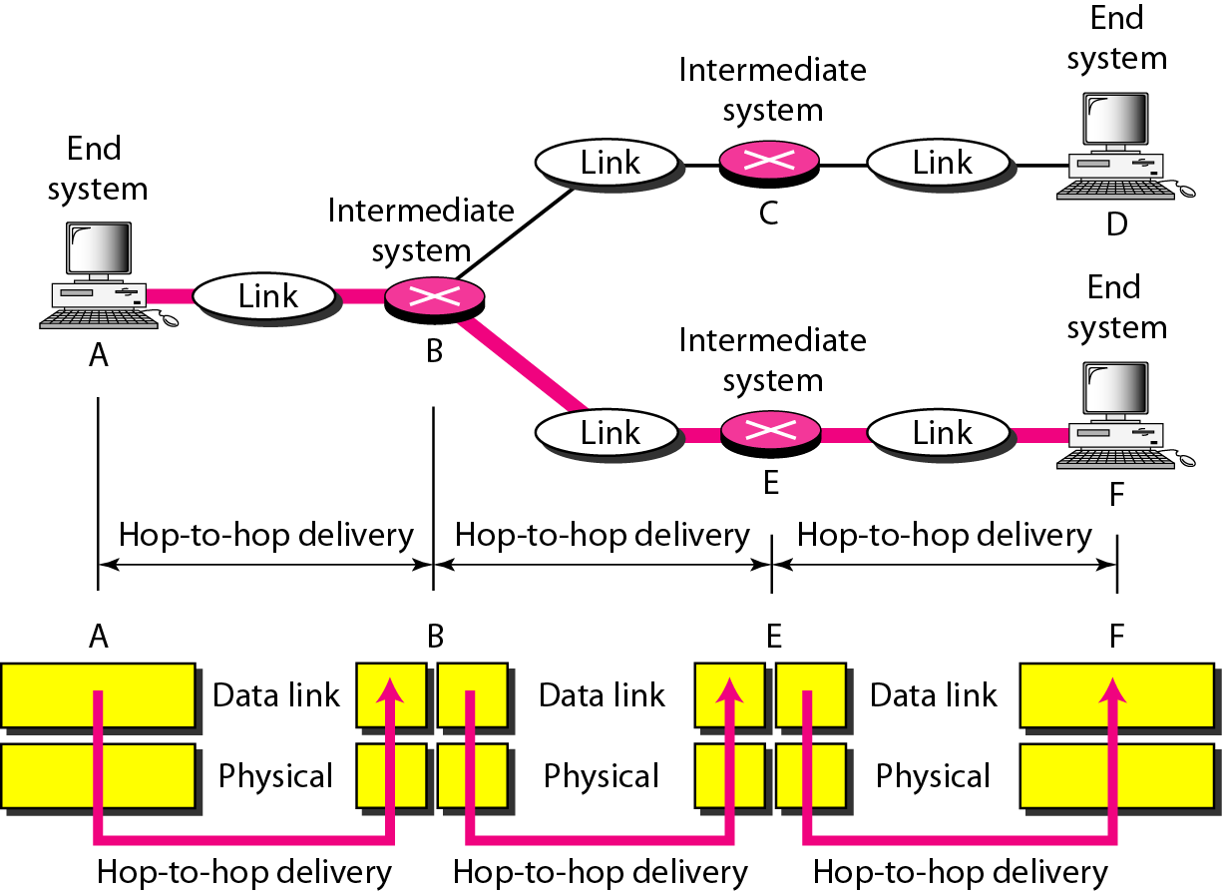
Figure 2.7 Hop-to-hop delivery

Slide 48
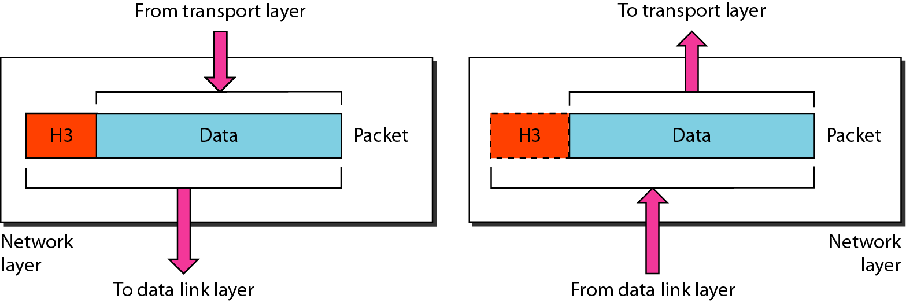
Figure 2.8 Network layer

Slide 49
Layer 3: The Network Layer
PDU: Packet
End to end delivery of packets
Creates logical paths
Path determination (routing)
Hides the lower layers making things hardware independent
Uses logical hierarchical addresses

Slide 50
The Network Layer (cont.)
Logical hierarchical addresses do change when a node is moved to a new subnet
Devices: routers, firewalls
The network layer is responsible for the delivery of individual packets from
the source host to the destination host

Slide 51
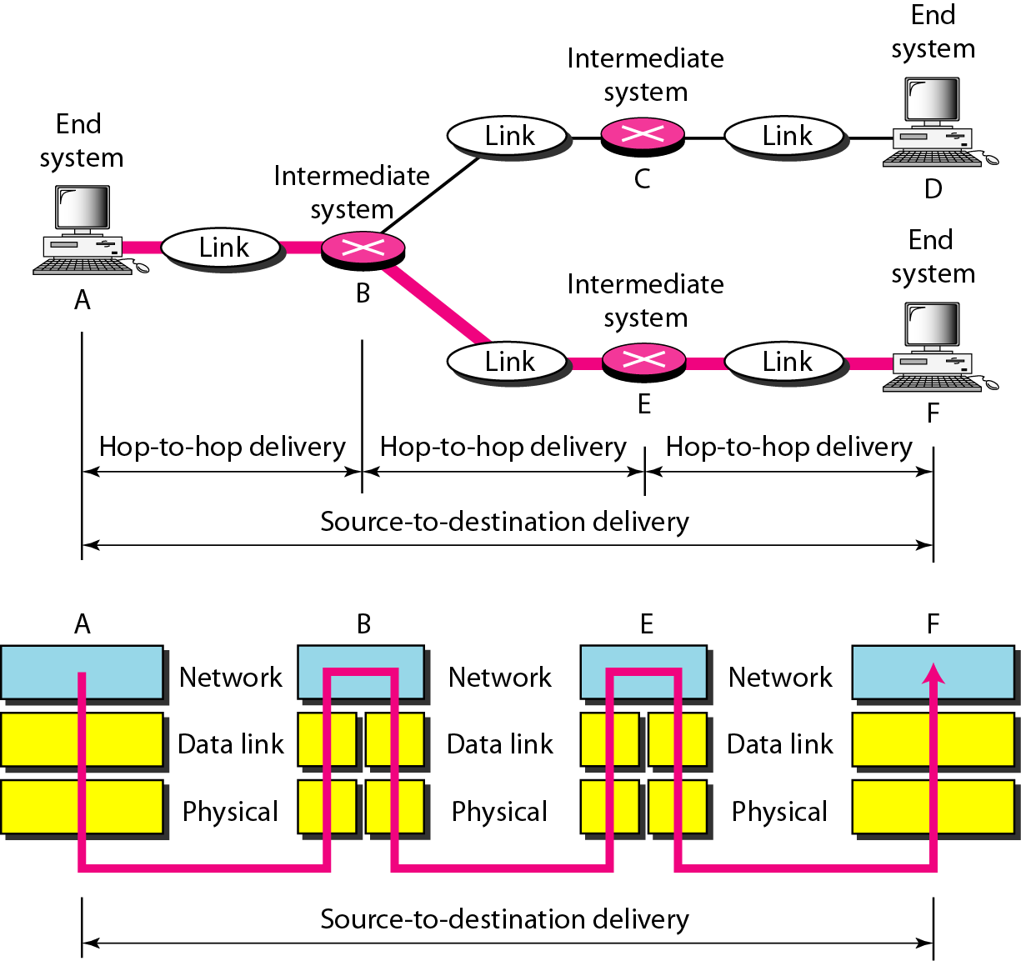
Figure 2.9 Source-to-destination delivery

Slide 52
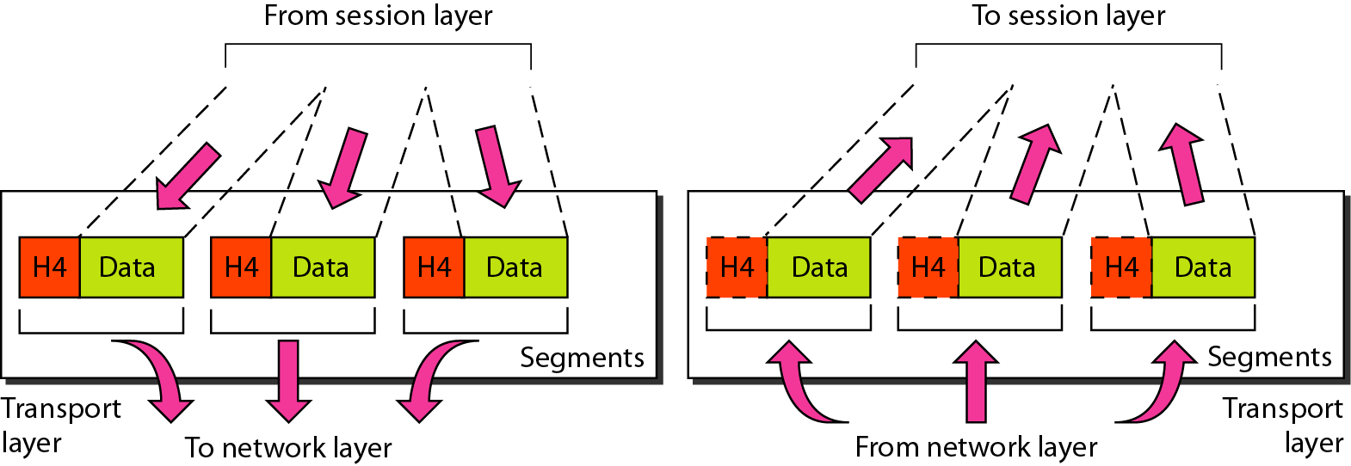
Figure 2.10 Transport layer

Slide 53
Layer 4: The Transport Layer
PDU: Segment
Service Point Address (more often called a port) used to track multiple sessions between the same systems. SPA’s are used to allow a node to offer more than one service (i.e. it could offer both mail and web services)
This layer is why you have to specify TCP or UDP when dealing with TCP/IP

Slide 54
The Transport Layer (cont.)
Must reassemble segments into data using sequence numbers
Can use either connectionless or connection oriented sessions
Connectionless sessions rely on upper layer protocols for error control and are often used for faster less reliable links
Ex: UDP (used by things like NFS & DNS)

Slide 55
The Transport Layer (cont.)
Connection oriented sessions require the sender to first request a connection, the receiver to acknowledge the connection, and that they negotiate how much data can be sent/received before its reception is acknowledged
Uses acknowledgements & retransmission for error correction
Example: TCP (used by things like telnet, http)
The transport layer is responsible for the delivery of a message from one process to another.

Slide 56
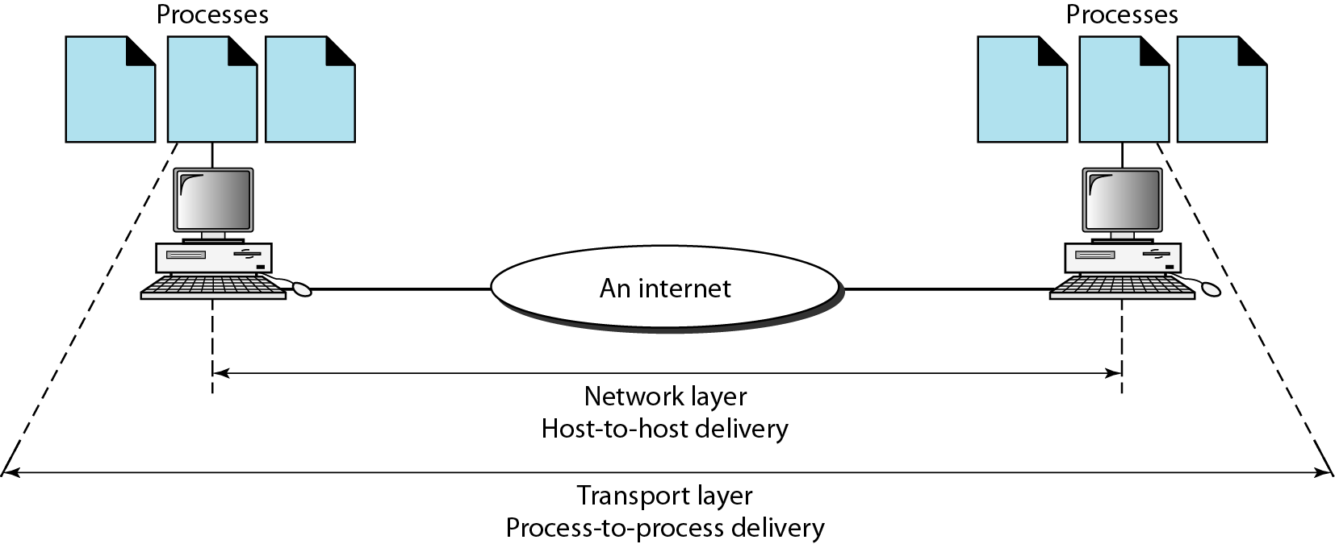
Figure 2.11 Reliable process-to-process delivery of a message

Slide 57
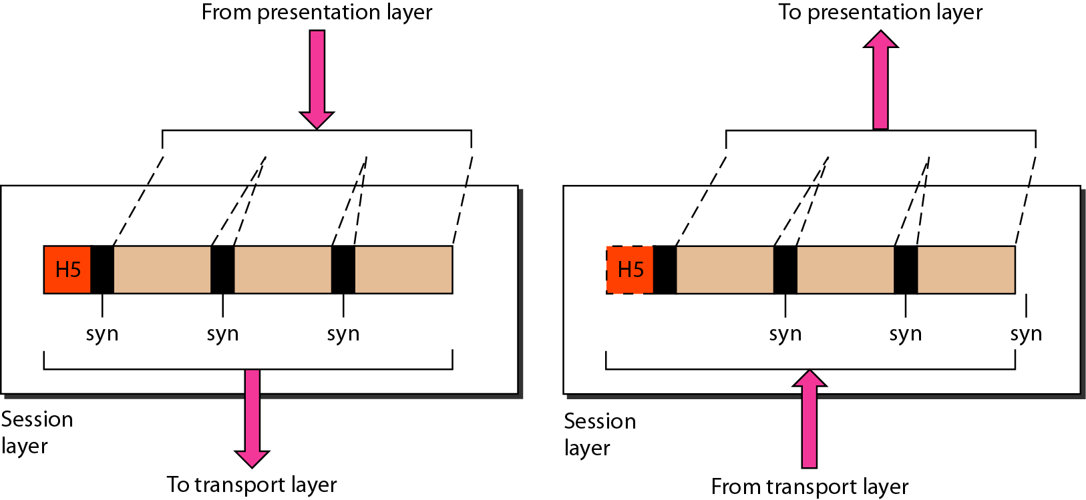
Figure 2.12 Session layer

Slide 58
Layer 5: The Session Layer
PDU: Data (from here on up)
Sometimes called the dialog controller, this layer establishes, maintains, and terminates sessions between applications
Sets duplex between applications
Defines checkpoints for acknowledgements during sessions between applications

Slide 59
The Session Layer (cont.)
Provides atomization – Multiple connections can be treated as one virtual session. If one fails or is terminated, all should be terminated.
Identifies raw data as either application data or session control information
Uses fields provided by layers 3 & 4 to track dialogs between applications / services
Provides translations for naming services
Ex: RPC, X-Windows, LDAP, NFS
The session layer is responsible for dialog control and synchronization.

Slide 60
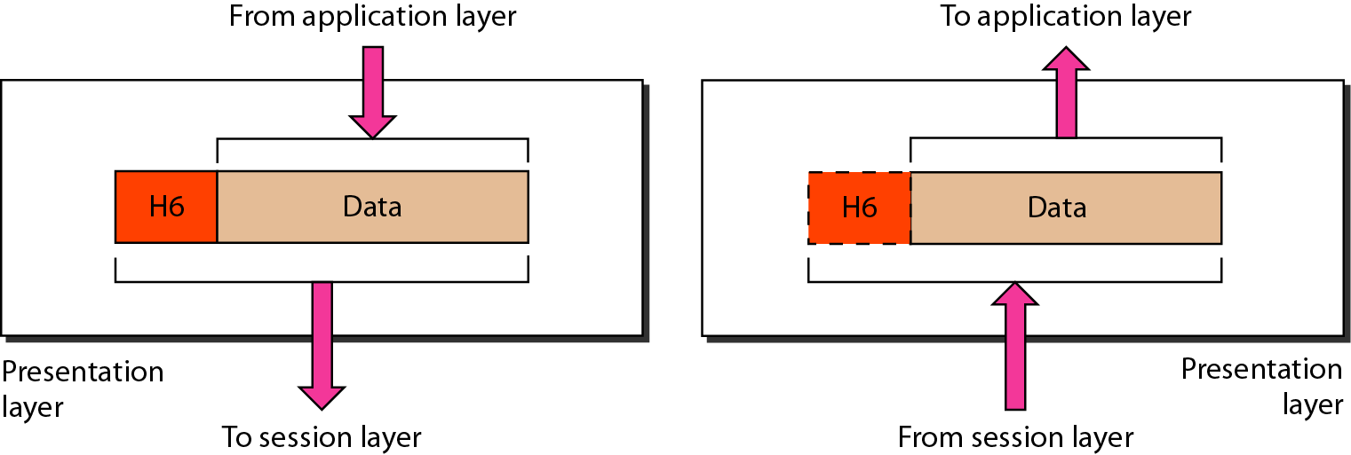
Figure 2.13 Presentation layer

Slide 61
Layer 6: The Presentation Layer
Data formatting, translation, encryption, and compression
Ex: ASCII, EBCDIC, HTML, JPEG
The presentation layer is responsible for translation, compression, and encryption.

Slide 62
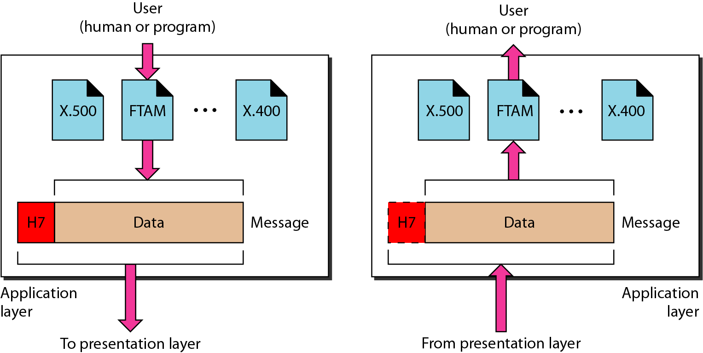
Figure 2.14 Application layer

Slide 63
Layer 7: The Application Layer
Provides communication services to applications
Ex: HTTP, FTP, SMTP
The application layer is responsible for providing services to the user.

Slide 64
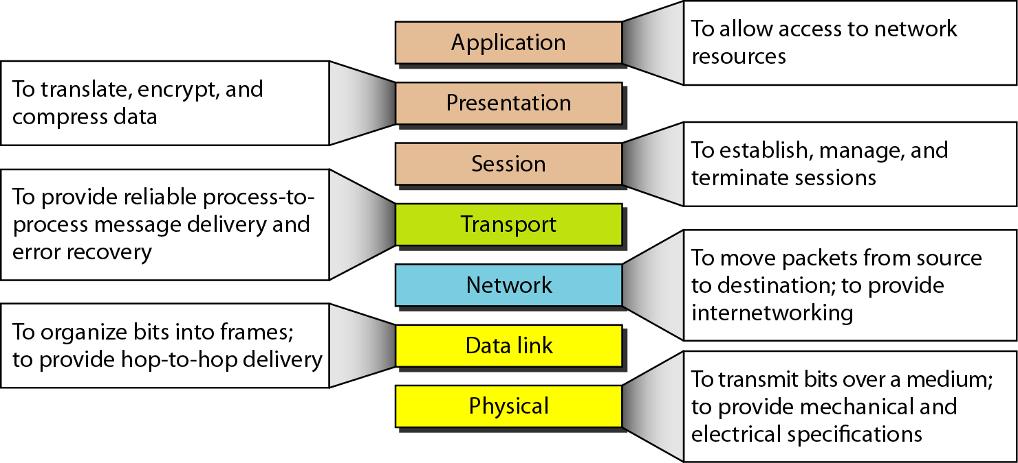
Figure 2.15 Summary of layers

Slide 65
2-4 TCP/IP PROTOCOL SUITE
The layers in the TCP/IP protocol suite do not exactly match those in the OSI model.
The original TCP/IP protocol suite was defined as having four layers: host-to-network, internet, transport, and application.
When TCP/IP is compared to OSI, we can say that the TCP/IP protocol suite is made of five layers: physical, data link, network, transport, and application.

Slide 66
TCP/IP Model
Much older than OSI model
Consists of 4 layers instead of 7
TCP/IP model can be mapped to the OSI model

Slide 67
TCP/IP vs OSI
TCP/IP | OSI
Application | Application Presentation Session (Layers 7-5)
Transport | Transport (Layer 4)
Internet | Network (Layer 3)
Network Interface | Data Link Physical (Layers 1-2)

Slide 68
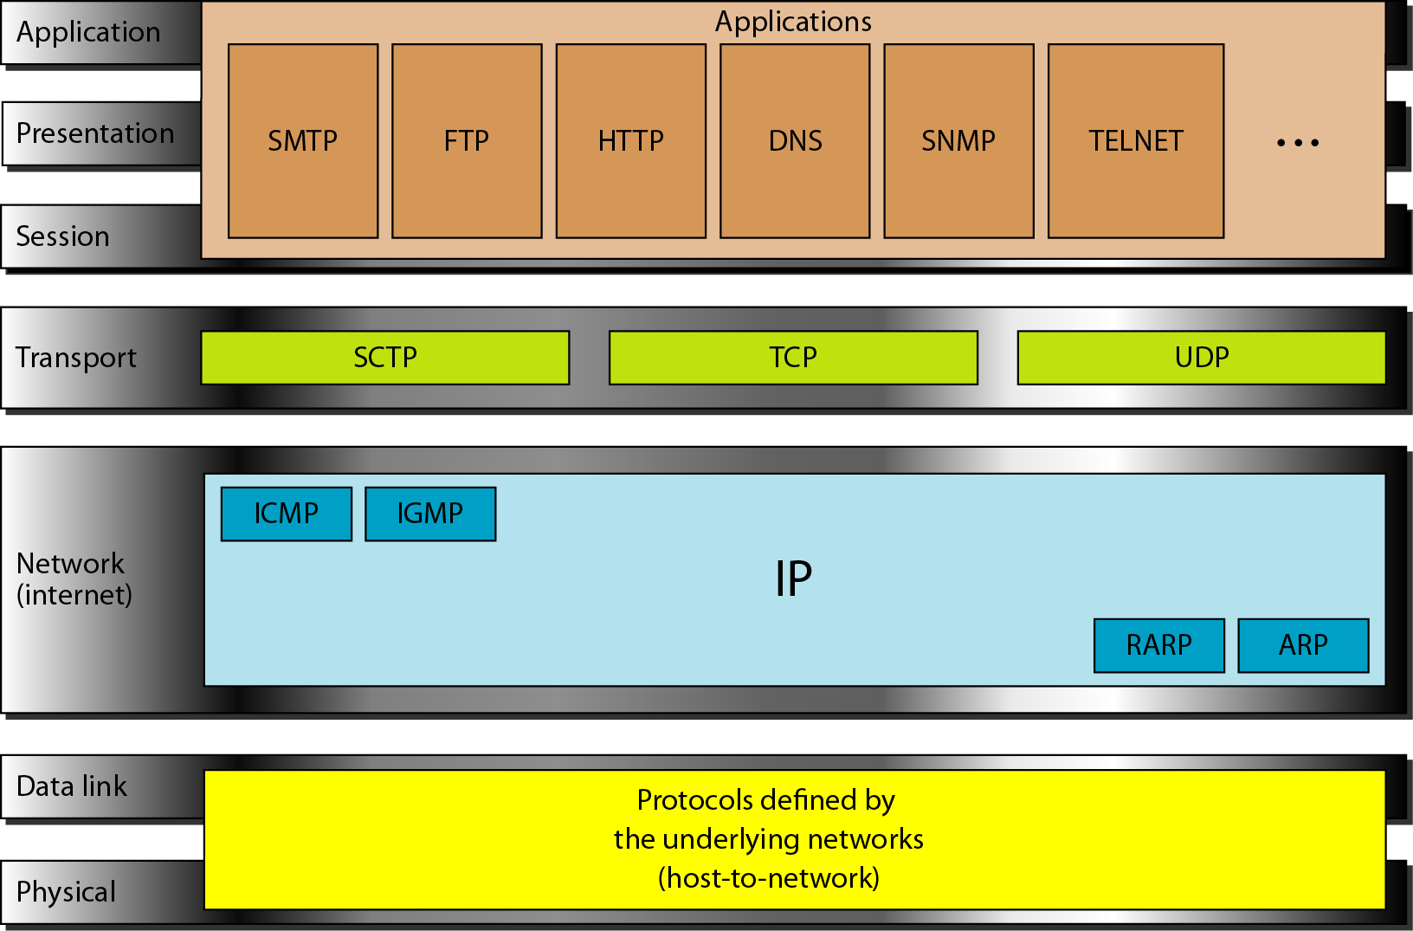
Figure 2.16 TCP/IP and OSI model

Slide 69
2-5 ADDRESSING
Four levels of addresses are used in an internet employing the TCP/IP protocols: physical, logical, port, and specific.
Topics discussed in this section:
Physical Addresses Logical Addresses Port Addresses Specific Addresses

Slide 70
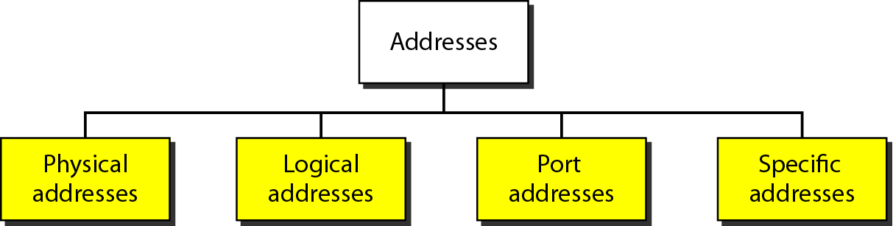
Figure 2.17 Addresses in TCP/IP

Slide 71
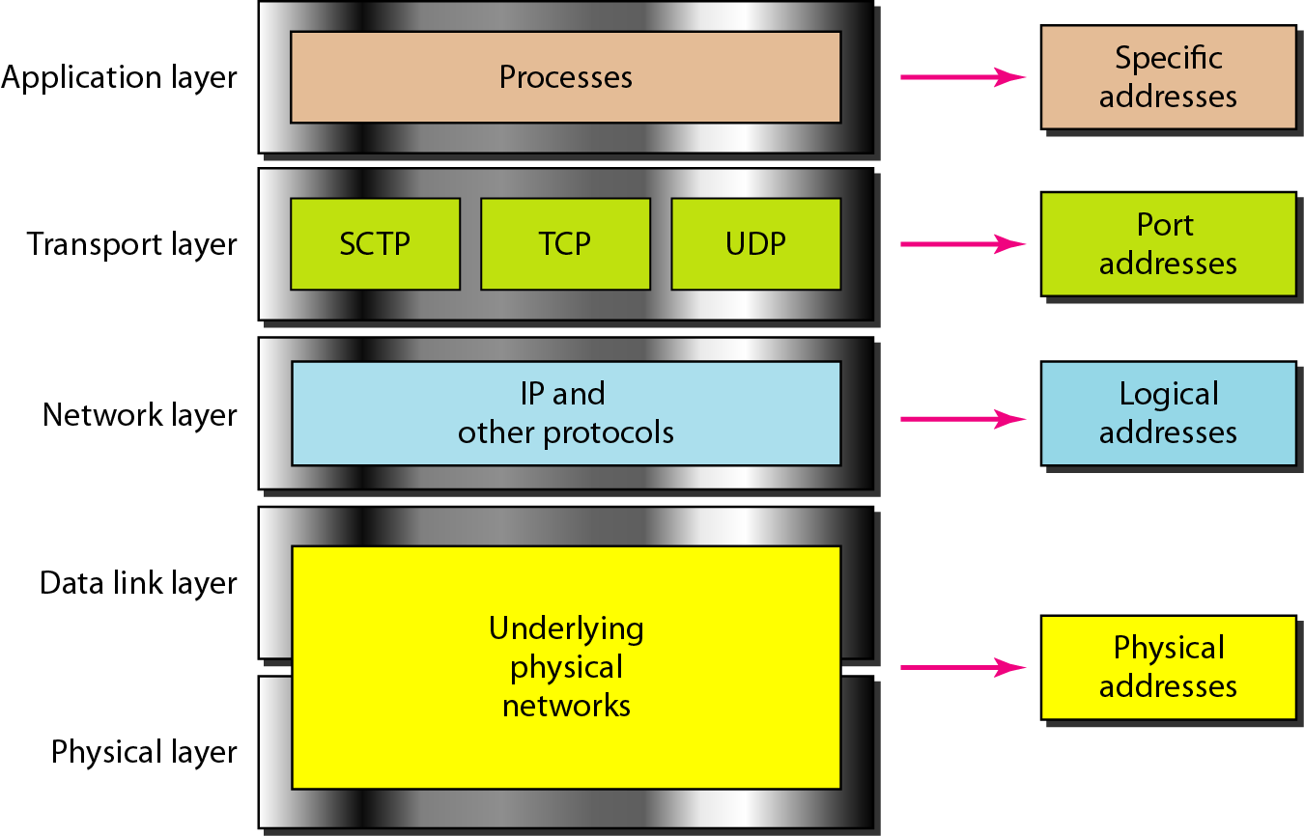
Figure 2.18 Relationship of layers and addresses in TCP/IP

Slide 72
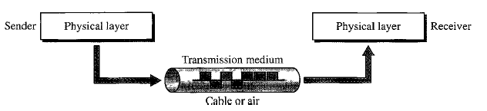
Transmission media

Slide 73
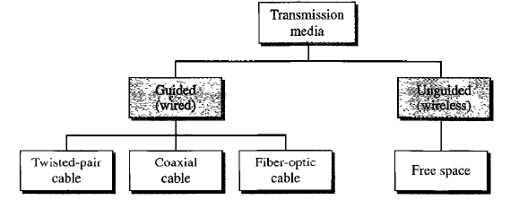
Transmission Media
Guided Medium
Twisted-Pair cable
(metallic)
Co-axial cable
(metallic)
Fiber-optic cable(light)
Unguided Medium
(Wireless)
Radio Waves
Microwaves
Infrared

Slide 74
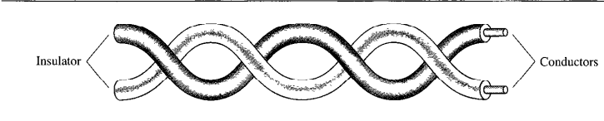
Transmission Media

Slide 75
Transmission Media
Categories:
7 types
Connectors:
RJ45(registered jack)
Performance:
Attenuation Vs Frequency and distance
Application:
Used in telephone lines

Slide 76
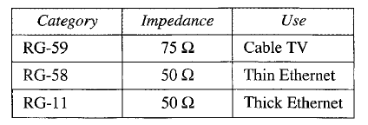
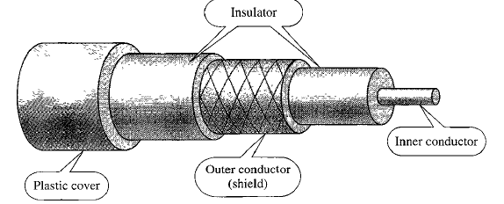
Co-axial Cable(coax)
Categories:

Slide 77
Carries signal of higher frequency ranges.
It has a central core conductor of solid or stranded wire enclosed in insulating sheath.
BNC Connector(Bayone Neill Concelman)

Slide 78
Coaxial Cable - Transmission Characteristics
superior frequency characteristics to TP
performance limited by attenuation & noise
analog signals
amplifiers every few km
closer if higher frequency
up to 500MHz
digital signals
repeater every 1km
closer for higher data rates
Notes:
Coaxial cable is used to transmit both analog and digital signals. It has frequency characteristics that are superior to those of twisted pair and can hence be used effectively at higher frequencies and data rates. Because of its shielded, concentric construction, coaxial cable is much less susceptible to interference and crosstalk than twisted pair. The principal constraints on performance are attenuation, thermal noise, and intermodulation noise. The latter is present only when several channels (FDM) or frequency bands are in use on the cable.
For long-distance transmission of analog signals, amplifiers are needed every few kilometers, with closer spacing required if higher frequencies are used. The usable spectrum for analog signaling extends to about 500 MHz. For digital signaling, repeaters are needed every kilometer or so, with closer spacing needed for higher data rates.

Slide 79
Co-axial cable connectors
Bayone-Neill-Concelman(BNC) connectors

Slide 80
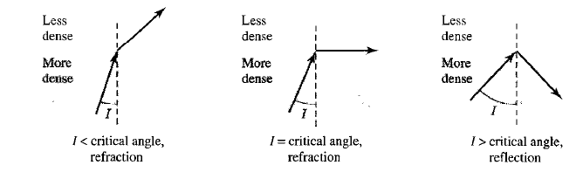
Fiber-optic cable
Made of glass or plastic and transmits signals in the form of light.
Bending of light ray

Slide 81
Angle of Incidence- The angle the ray makes with the line perpendicular to the interface between the two substances.
Angle of incidence < critical angle, ray refracts and moves closer to the surface
Angle of incidence= critical angle, light bends along the interface.
Angle> critical angle, ray reflects and travels again the denser surface.
Optical fiber uses reflection to guide light through a channel.

Slide 82
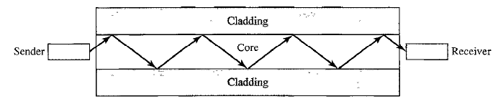
A glass or plastic core is surrounded by a cladding of less dense glass or plastic.
The difference in density should be such that beam of light is reflected off instead of being refracted.

Slide 83
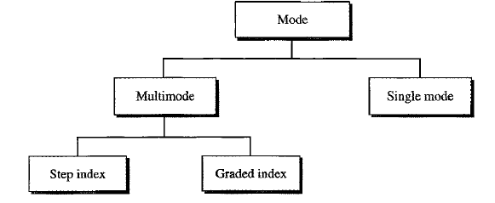
PROPAGATION MODES:
Multimode-Multiple beam
from a light source move
through the core in
different paths.
Step index:
Density of core remain constant from center to edges.
Beam of light move through a constant density in a straight line
There is abrupt change in density at the interface.

Slide 84
Graded-index:
Varying densities.
Index of refraction is related to densities.
Density is the highest at the center and lowest towards the edges.
Single-mode:
Uses step-index.
Highly focused source of light that limits beam to a small range of angles, all close to horizontal.
Small diameter, substantially lower density.

Slide 85
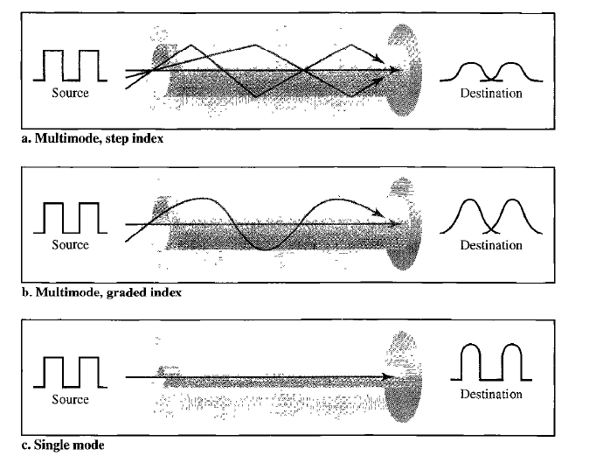

Slide 86
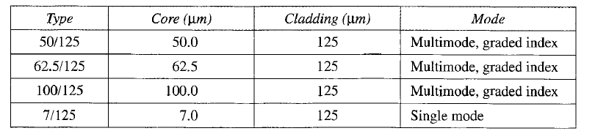
Fiber sizes

Slide 87
Ratio of diameter of the core to the diameter of the cladding.
CABLE CONNECTORS:
Subscriber-channel connector(SC)-used in cable TV. Uses push/pull locking system.
Straight-tip connector(ST)-connecting cable to network devices.uses Bayonate locking system.
MT-RJ Connector

Slide 88
Optical Fiber - Transmission Characteristics
uses total internal reflection to transmit light
effectively acts as wave guide for 10¹⁴ to 10¹⁵ Hz
can use several different light sources
Light Emitting Diode (LED)
cheaper, wider operating temp range, lasts longer
Injection Laser Diode (ILD)
more efficient, has greater data rate
relation of wavelength, type & data rate
Notes:
Optical fiber transmits a signal-encoded beam of light by means of total internal reflection. Total internal reflection can occur in any transparent medium that has a higher index of refraction than the surrounding medium. In effect, the optical fiber acts as a waveguide for frequencies in the range of about 10¹⁴ to 10¹⁵ Hertz; this covers portions of the infrared and visible spectra.
Two different types of light source are used in fiber optic systems: the light-emitting diode (LED) and the injection laser diode (ILD). Both are semiconductor devices that emit a beam of light when a voltage is applied. The LED is less costly, operates over a greater temperature range, and has a longer operational life. The ILD, which operates on the laser principle, is more efficient and can sustain greater data rates.
There is a relationship among the wavelength employed, the type of transmission, and the achievable data rate. Both single mode and multimode can support several different wavelengths of light and can employ laser or LED light sources.

Slide 89
applications
Self Study..

Slide 90
advantages
Higher Bandwidth
Less signal Attenuation
Immunity to Electromagnetic Interference
Resistance to Corrosive Materials
Light weight
Greater Immunity to Tapping.

Slide 91
disadvantages
Installation and Maintenance
Cost
Unidirectional light propagation

Slide 92
Digital-to-digital conversion
We can represent digital data by using digital signals.
The conversion involves 3 techniques.
Line coding
Block coding
Scrambling

Slide 93
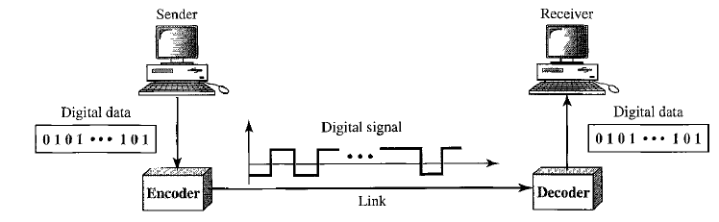
Line coding
Line Coding is a process of converting digital data to digital signals.(Sequence of bits to digital signals)
Digital data are encoded into digital signals at the sender; Digital data are recreated by decoding the digital signal at the receiver.

Slide 94
characteristics
Signal element Versus Data Element:
Signal element is the shortest unit of digital signal; Data element is the smallest entity that can represent a piece of information.
Signal element carries data element(what we can send); Data elements are what we need to send.
Data elements- carried; Signal elements are carriers.
R-No. of data elements carried by each signal element.

Slide 95
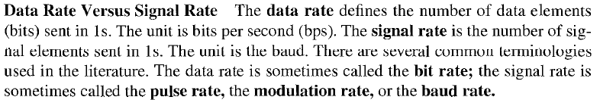
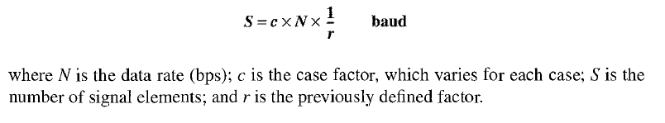
Data rate Versus Signal rate:

Slide 96
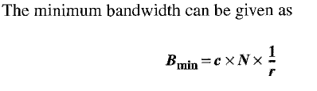
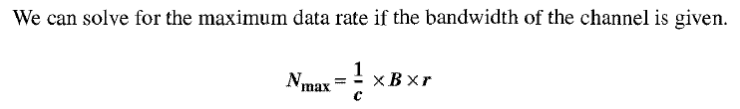
BANDWIDTH:Bandwidth is proportional to the signal rate.

Slide 97
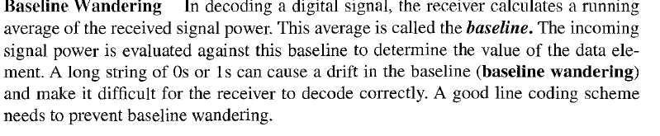
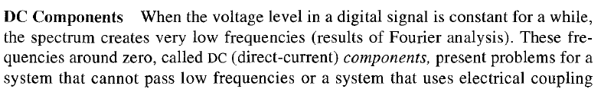

Slide 98
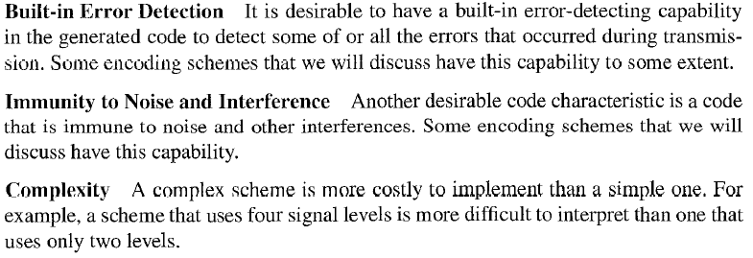

Slide 99
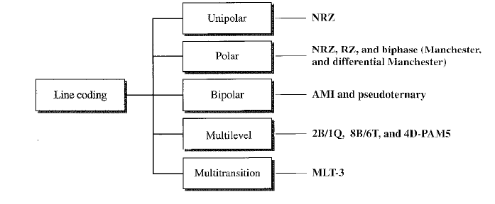
Line coding schemes

